Slide 1
2019 Montgomery County Arrests
Mohamed Nabeel

Slide 2
Data Set
Crime_Year_To_Date_-_2019.csv
Retrieved from Data Montgomery Website.
Updated on a daily basis.
Reported crimes classified according to the National Incident-Based Reporting System (NIBRS) of the Criminal Justice Information Services (CJIS) Division Uniform Crime Reporting (UCR) Program and documented by approved police incident reports.

Slide 3
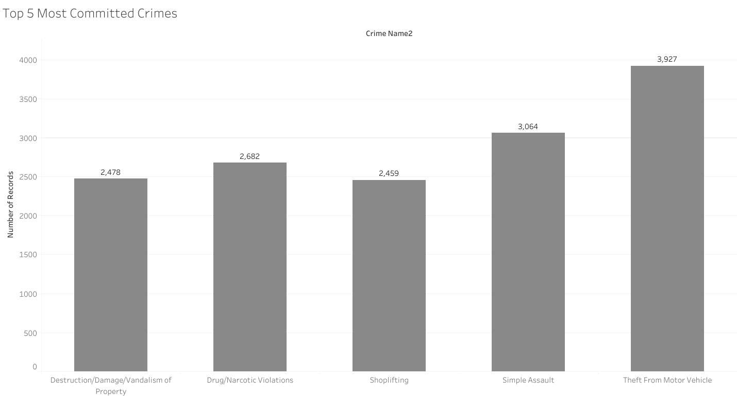
Top 5 Most Committed Crimes

Slide 4
Most Committed Crimes Importance
Which crimes we need to combat against the most.
Which crimes we need to be ready for.
Which crimes affect people the most.

Slide 5
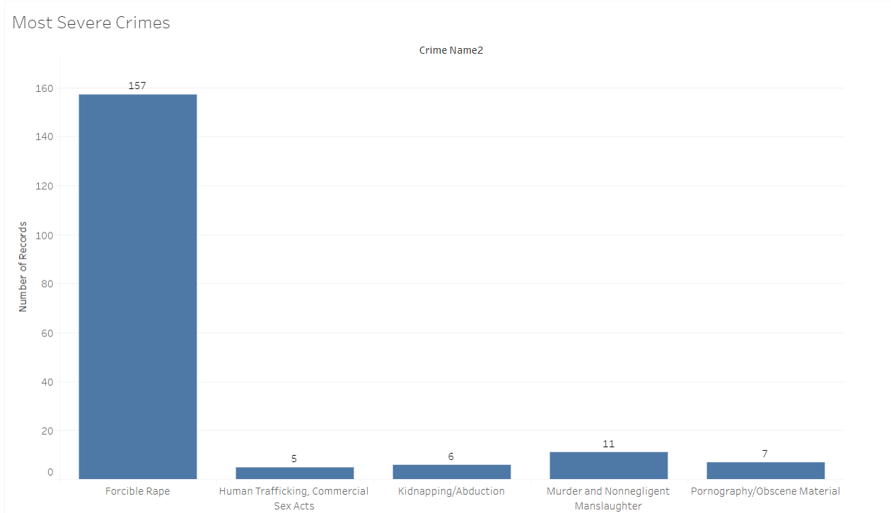
Severity

Slide 6
Severity Importance
Which crimes we should be most aware of.

Slide 7
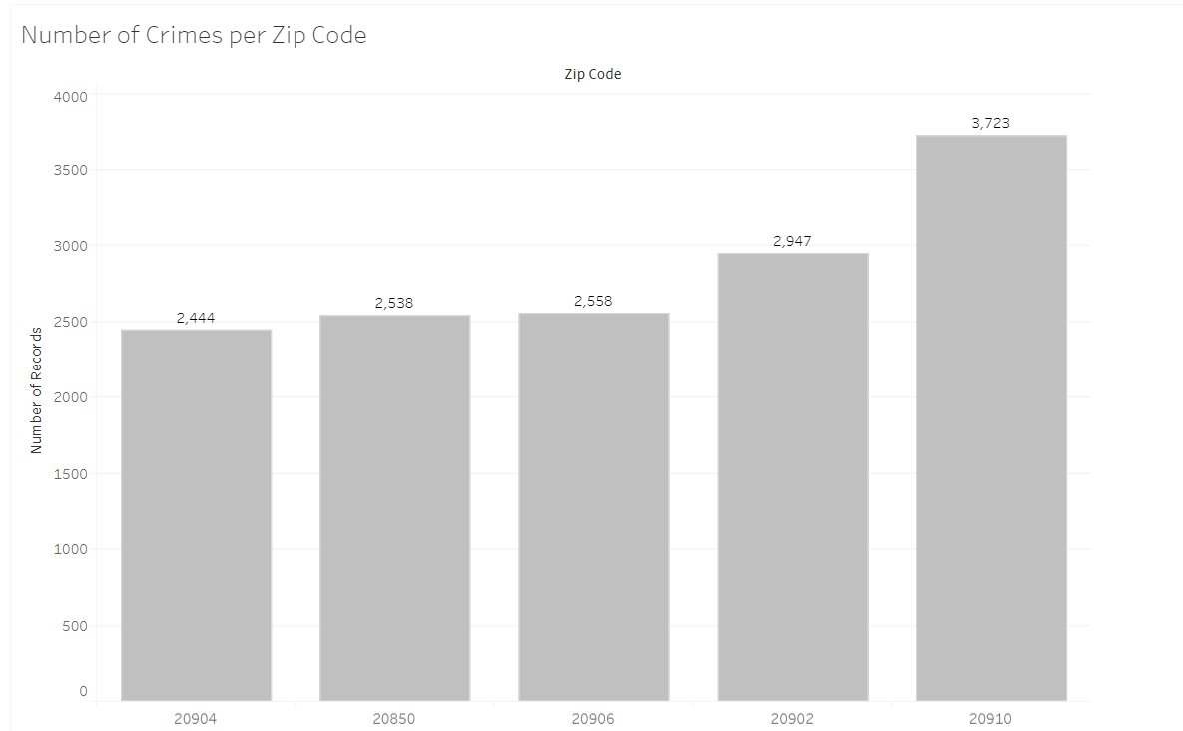
Victim per Crime

Slide 8
Zip Code
20910 – Silver Spring
20902 – Silver Spring
20906 – Silver Spring
20850 – Rockville
20904 – Silver Spring

Slide 9
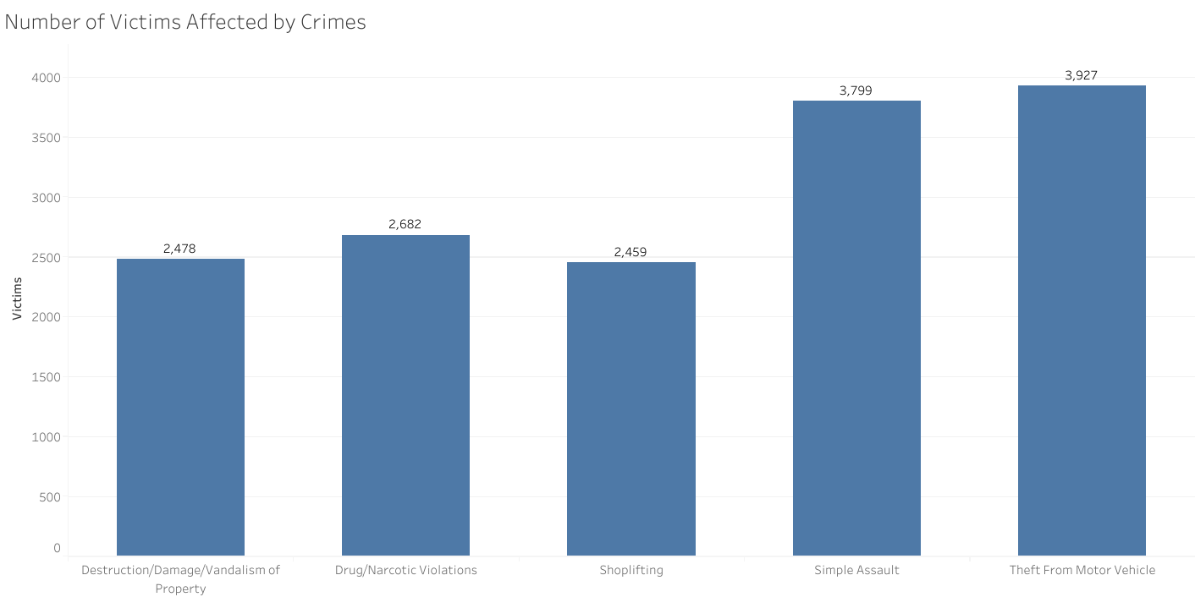
Number of Victims affected Per Crime

Slide 10
A deeper look
https://data.montgomerycountymd.gov/Public-Safety/Victim-Pie-chart/4qkx-ekgd

Slide 11
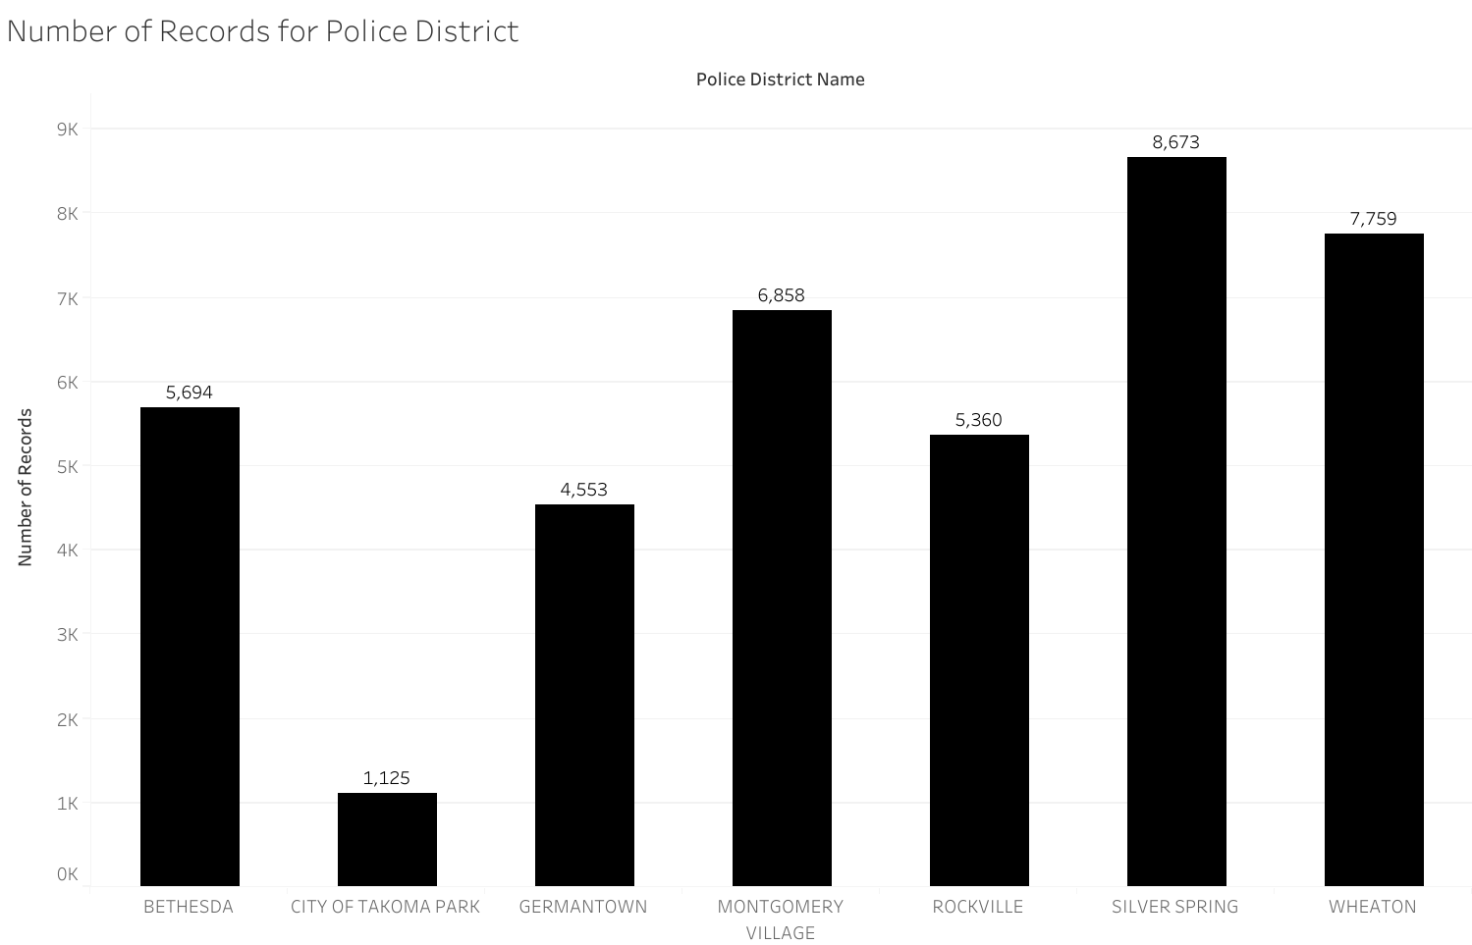
Police Districts Record

Slide 12
Police District Importance
See which districts handle the most cases.
Provide more funding for those districts.
Provide more equipment for those districts.
Hire more personnel for those districts.

Slide 13
Crime Map of Incidents
https://data.montgomerycountymd.gov/Public-Safety/Crime-map/jwma-dree

Slide 14
Location Importance
Which areas have more crime than other
Which areas may need more officers patrolling the area

Slide 15
Any Questions?
Thank you!

